Slide 1
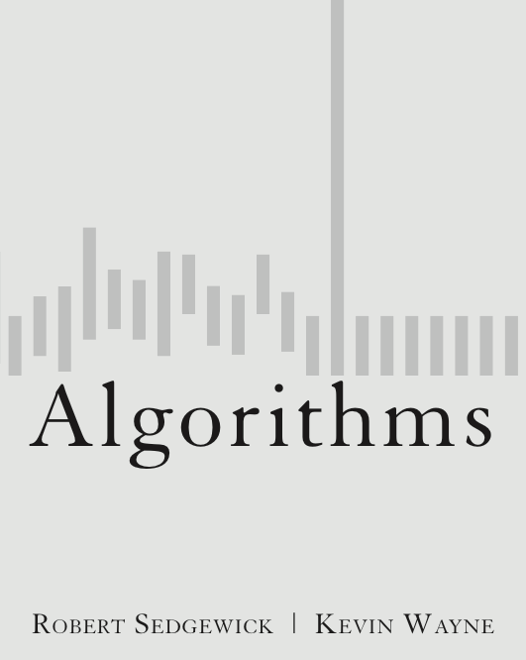
3.1 Symbol Tables
http://algs4.cs.princeton.edu

Slide 2
Symbol tables
Key-value pair abstraction.
Insert a value with specified key.
Given a key, search for the corresponding value.
Ex. DNS lookup.
Insert domain name with specified IP address.
Given domain name, find corresponding IP address.
domain name | IP address
www.cs.princeton.edu | 128.112.136.11
www.princeton.edu | 128.112.128.15
www.yale.edu | 130.132.143.21
www.harvard.edu | 128.103.060.55
www.simpsons.com | 209.052.165.60
key
value
Notes:
DNS = domain name system
We’ll focus on insert, search
Can interchange roles: given IP address find corresponding URL

Slide 3
Symbol table applications
application | purpose of search | key | value
dictionary | find definition | word | definition
book index | find relevant pages | term | list of page numbers
file share | find song to download | name of song | computer ID
financial account | process transactions | account number | transaction details
web search | find relevant web pages | keyword | list of page names
compiler | find properties of variables | variable name | type and value
routing table | route Internet packets | destination | best route
DNS | find IP address | domain name | IP address
reverse DNS | find domain name | IP address | domain name
genomics | find markers | DNA string | known positions
file system | find file on disk | filename | location on disk
Notes:
Google: database of over 3 billion pages, 140 million queries per day!
Search problem core of many real-world applications (Think Google).
"Associative memory." Index of any kind.

Slide 4
Symbol tables: context
Also known as: maps, dictionaries, associative arrays.
Generalizes arrays. Keys need not be between 0 and N – 1.
Language support.
External libraries: C, VisualBasic, Standard ML, bash, ...
Built-in libraries: Java, C#, C++, Scala, ...
Built-in to language: Awk, Perl, PHP, Tcl, JavaScript, Python, Ruby, Lua.
every array is an
associative array
every object is an
associative array
table is the only
primitive data structure
hasNiceSyntaxForAssociativeArrays["Python"] = true
hasNiceSyntaxForAssociativeArrays["Java"] = false
legal Python code
Notes:
DNS = domain name system
We’ll focus on insert, search
Can interchange roles: given IP address find corresponding URL

Slide 5
Basic symbol table API
Associative array abstraction. Associate one value with each key.
public class ST<Key, Value>
 | ST() | create an empty symbol table
void | put(Key key, Value val) | put key-value pair into the table
Value | get(Key key) | value paired with key
boolean | contains(Key key) | is there a value paired with key?
void | delete(Key key) | remove key (and its value) from table
boolean | isEmpty() | is the table empty?
int | size() | number of key-value pairs in the table
Iterable<Key> | keys() | all the keys in the table
a[key] = val;
a[key]
Notes:
a[key] = val is legal notation in many modern languages, but not Java

Slide 6
Conventions
Values are not null.
Method get() returns null if key not present.
Method put() overwrites old value with new value.
Intended consequences.
Easy to implement contains().
Can implement lazy version of delete().
Java allows null value
public boolean contains(Key key)
{ return get(key) != null; }
public void delete(Key key)
{ put(key, null); }
Notes:
If we associate null with the deleted key, the client won't know the difference

Slide 7
Keys and values
Value type. Any generic type.
Key type: several natural assumptions.
Assume keys are Comparable, use compareTo().
Assume keys are any generic type, use equals() to test equality.
Assume keys are any generic type, use equals() to test equality; use hashCode() to scramble key.
Best practices. Use immutable types for symbol table keys.
Immutable in Java: Integer, Double, String, java.io.File, …
Mutable in Java: StringBuilder, java.net.URL, arrays, ...
specify Comparable in API.
built-in to Java
(stay tuned)
Notes:
Q. Why is immutable desirable?
A. If you store keys in order and the key changes, you might be in big trouble!

Slide 8
Equality test
All Java classes inherit a method equals().
Java requirements. For any references x, y and z:
Reflexive: x.equals(x) is true.
Symmetric: x.equals(y) iff y.equals(x).
Transitive: if x.equals(y) and y.equals(z), then x.equals(z).
Non-null: x.equals(null) is false.
Default implementation. (x == y)
Customized implementations. Integer, Double, String, java.io.File, …
User-defined implementations. Some care needed.
equivalence relation
do x and y refer to
the same object?
Notes:
First, we start by implementing equality check. Get into programming language issues.
Consistency: multiple invocations of x.equals(y) return the same value, provided neither changes between invocations.

Slide 9
Equals design
"Standard" recipe for user-defined types.
Optimization for reference equality.
Check against null.
Check that two objects are of the same type and cast.
Compare each significant field:
if field is a primitive type, use ==
if field is an object, use equals()
if field is an array, apply to each entry
Best practices.
No need to use calculated fields that depend on other fields.
Compare fields mostly likely to differ first.
Make compareTo() consistent with equals().
but use Double.compare() with double
(or otherwise deal with -0.0 and NaN)
apply rule recursively
can use Arrays.deepEquals(a, b)
but not a.equals(b)
e.g., cached Manhattan distance
x.equals(y) if and only if (x.compareTo(y) == 0)
Notes:
Arrays.deepEquals() for arrays of reference types (does it work with 2d arrays?)
a.equals(b) is the same as a == b for arrays.

Slide 10
ST test client for analysis
Frequency counter. Read a sequence of strings from standard input and print out one that occurs with highest frequency.
% more tinyTale.txt
it was the best of times
it was the worst of times
it was the age of wisdom
it was the age of foolishness
it was the epoch of belief
it was the epoch of incredulity
it was the season of light
it was the season of darkness
it was the spring of hope
it was the winter of despair
% java FrequencyCounter 1 < tinyTale.txt
it 10
% java FrequencyCounter 8 < tale.txt
business 122
% java FrequencyCounter 10 < leipzig1M.txt
government 24763
tiny example (60 words, 20 distinct)
real example (135,635 words, 10,769 distinct)
real example
(21,191,455 words, 534,580 distinct)

Slide 11
Frequency counter implementation, I -> Ith
Parallel Arrays
A
J
K
R
T
P
.
.
5
67
23
6
45
89
AK[i] ---> AV[i]
AK
AV
Notes:
incrementing counter exploits fact that duplicates are not permitted
Note: Only slightly more work required to build an index of all of the places where each key occurs in the text.

Slide 12
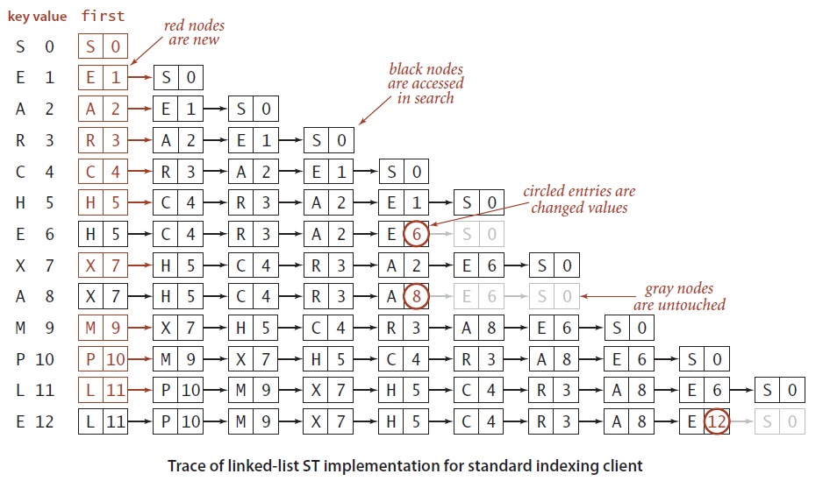
Sequential search in a linked list- Alternative way for Parallel Arrays
Data structure. Maintain an (unordered) linked list of key-value pairs.
Search. Scan through all keys until find a match.
Insert. Scan through all keys until find a match; if no match add to front.

Slide 13
Elementary ST implementations: summary
Challenge. Efficient implementations of both search and insert.
ST implementation | guarantee |  | average case |  | key interface
 | search | insert | search hit | insert
sequential search (unordered list) | N | N | N / 2 | N | ??()
Notes:
Average case = after N random inserts

Slide 14
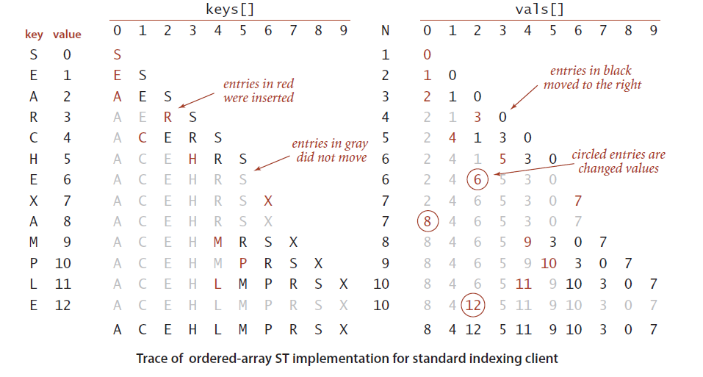
Binary search in an ordered array
Notes:
Average case = after N random inserts

Slide 15
Frequency counter implementation
BinarySearchParArrays_TBC.cpp
Notes:
incrementing counter exploits fact that duplicates are not permitted
Note: Only slightly more work required to build an index of all of the places where each key occurs in the text.

Slide 16
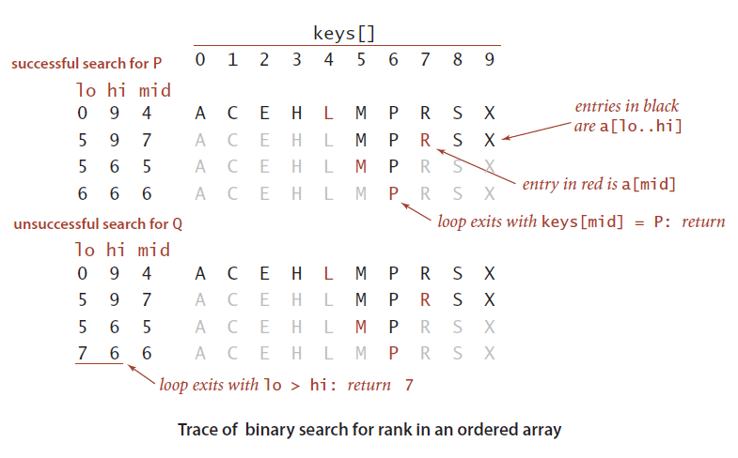
Binary search in an ordered array
Data structure. Maintain an ordered array of key-value pairs.
Rank helper function. How many keys < k ?
Notes:
Given a sorted array, determine index associated with a given key.
Ex. Dictionary, phone book, book index, …
Binary search algorithm: Examine the middle key; If it matches, return its index; Otherwise, search either the left or right half.
Can either maintain array of key-value aggregate objects or two parallel arrays

Slide 17
Binary search: C++ implementation

Slide 18
Binary search: mathematical analysis
Proposition. Binary search uses ~ lg N compares to search array of size N.
Pf. T(N) = number of compares to binary search in a sorted array of size N.
≤ T(⎣N / 2⎦) + 1
Recall lecture 2.
left or right half

Slide 19
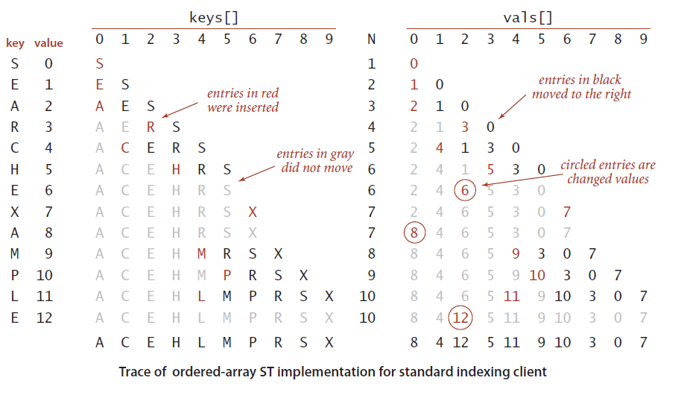
Binary search: trace of standard indexing client
Problem. To insert, need to shift all greater keys over.

Slide 20
Elementary ST implementations: summary
Challenge. Efficient implementations of both search and insert.
ST implementation | guarantee |  | average case |  | key interface
 | search | insert | search hit | insert
sequential search (unordered list) | N | N | N / 2 | N | equals()
binary search (ordered array) | log N | N | log N | N / 2 | compareTo()
Notes:
Binary search depends on array indexing for efficiency: Q. How can you jump to middle of a linked list? A. You can't do it efficiently!

